Slide 1
PROJECT X
By: Aparna Sundaram, Guru akash, Dwaj Ranka

Slide 2
TABLE OF CONTENTS
01
02
03
04
05
06
Problem Statement
Flowchart
Existing Model
Proposed Solution
User Journey
Business Model

Slide 3

EXECUTIVE SUMMARY
Project X is a website designed to assist startups in evaluating their potential for success. This evaluation is likely based on various metrics such as financial indicators, market analysis, growth projections, and other possible relevant factors. The website offers a comprehensive approach to helping startups gauge their viability and prospects in the business landscape.

Slide 4

01
PROBLEM STATEMENT

Slide 5
Problem Statement
A lot of start-ups fail because they are made without accurate market information and future potential. An overwhelming number of entrepreneurs do not have this information. There is need for case analysis and data on sectors to start businesses.

Slide 6
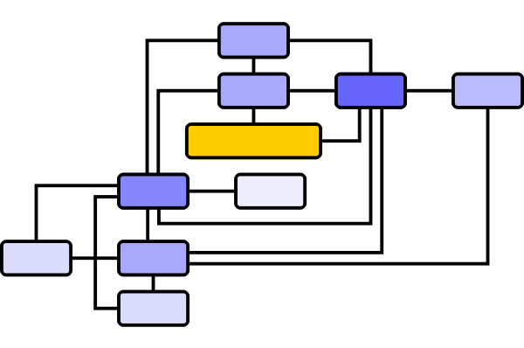
02
FLOWCHART

Slide 7
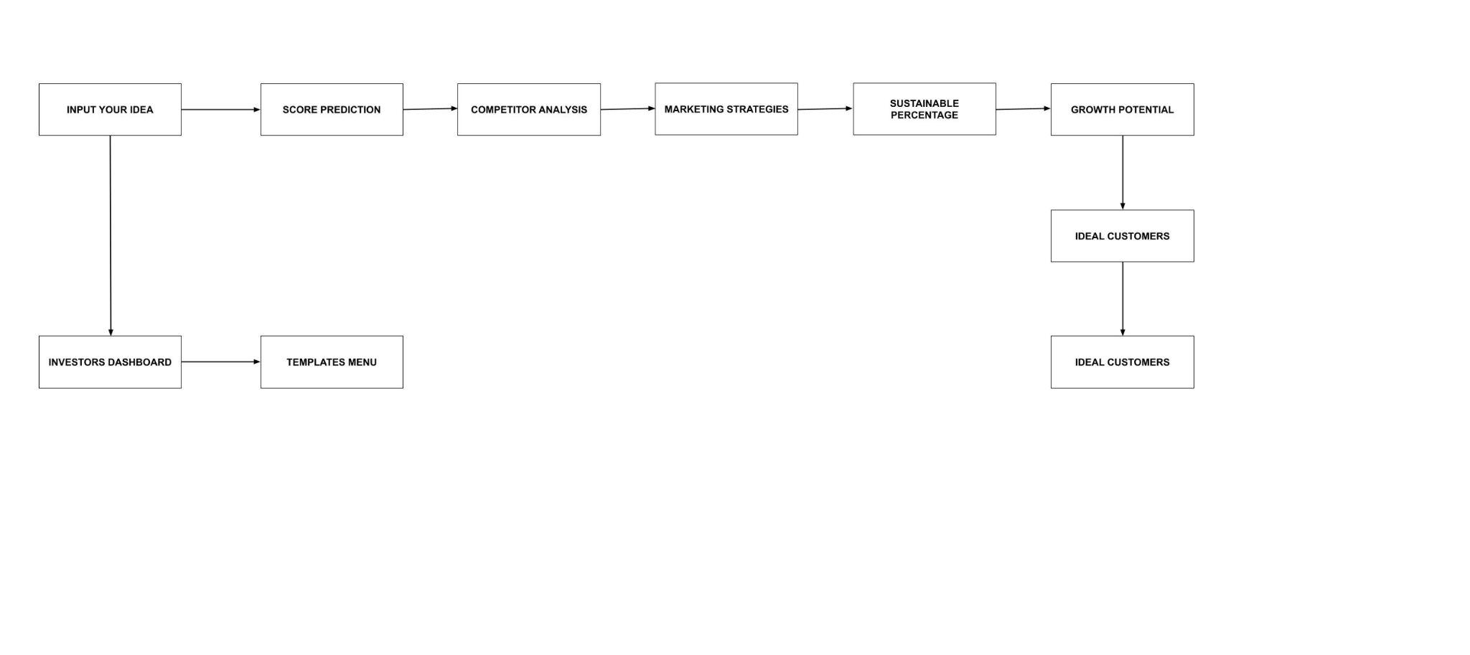

Slide 8

03
EXISTING METHODS

Slide 9
Market analysis
Industry overview
Target market
We are covering all the industries and we give a solution to all possible and innovative start ups
-Start-ups
-Investors

Slide 10
Existing Methods
There are no Existing Models in the current market where a startup gets an all in one package. The existing models are individual research that needs to be done by all the newbies in the market.

Slide 11
04
PROPOSED SOLUTION

Slide 12
PROPOSED SOLUTION
Our website takes care of:
Predictive Analysis
Summarization
Metric based Scoring
Sustainability
Pros and Cons
Competitive Analysis

